Slide 1
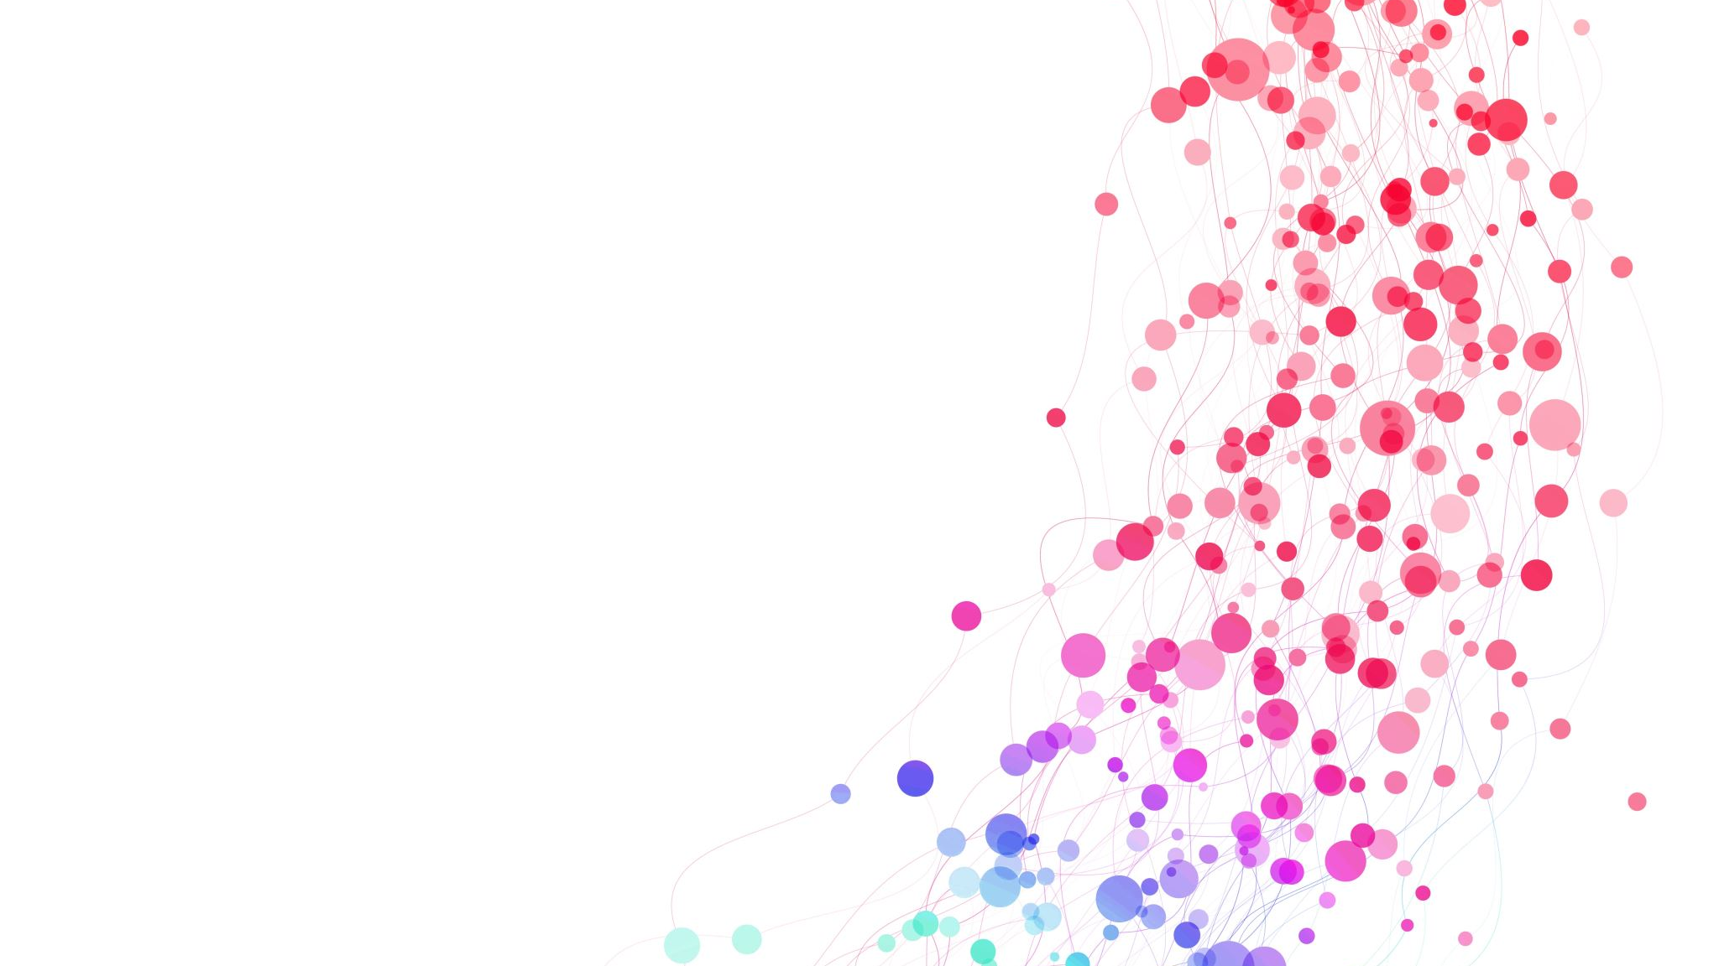
Model Performance and Quality Analysis
Mihaly Kavasi – Southampton Data Platform and Cloud Meetup – 13 March 2024

Slide 2







Introduction
Mihaly Kavasi
Group Manager
Delivery Lead and Trainer
Avanade
8+ Years of Power BI Experience
7+ Year of Training Experience
Microsoft Certified Solution Expert – Data Management and Analytics
Microsoft Certified Trainer
Azure Enterprise Data Analyst
Fasttrack Recognized Solution Architect
LinkedIn: Kavasi Mihaly
Blog: https://selfservicebi.co.uk/

Slide 3
Performance Analysis
To provide good user experience the performance of the report plays a crucial role.
The perceived performance are influenced by a lot of different factors:
End user hardware
Quality and speed of the network
Security settings
Physical distance from the server
Complexity of the report
Quality of the model

Slide 4
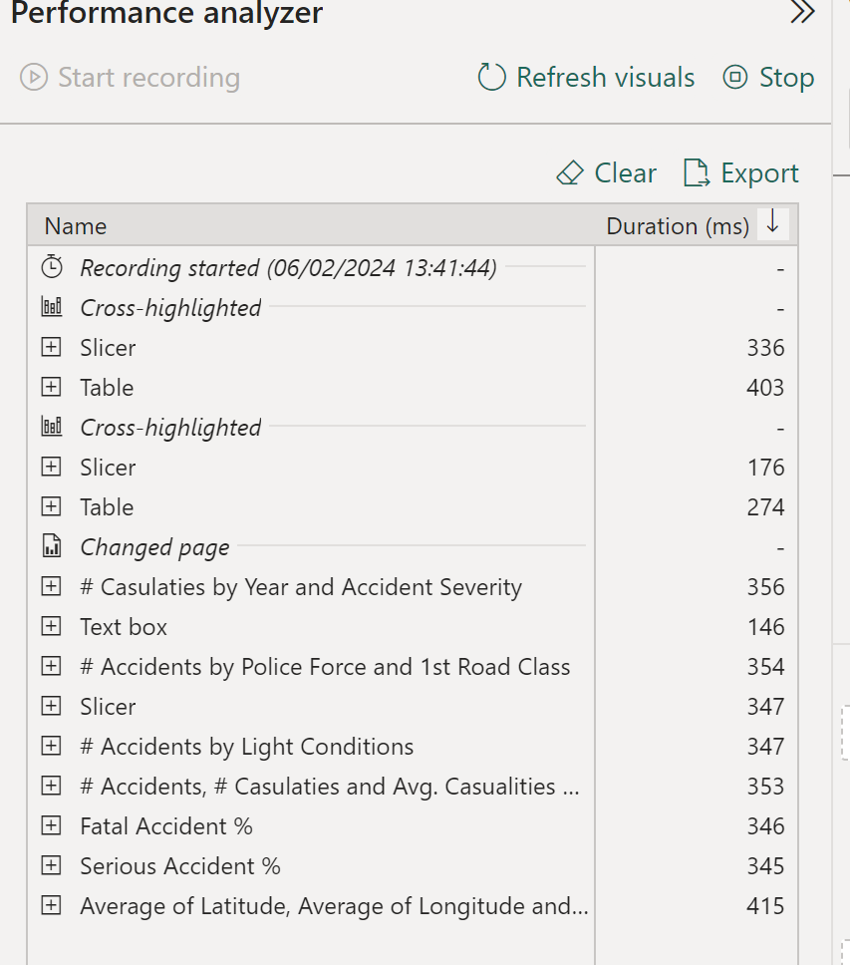
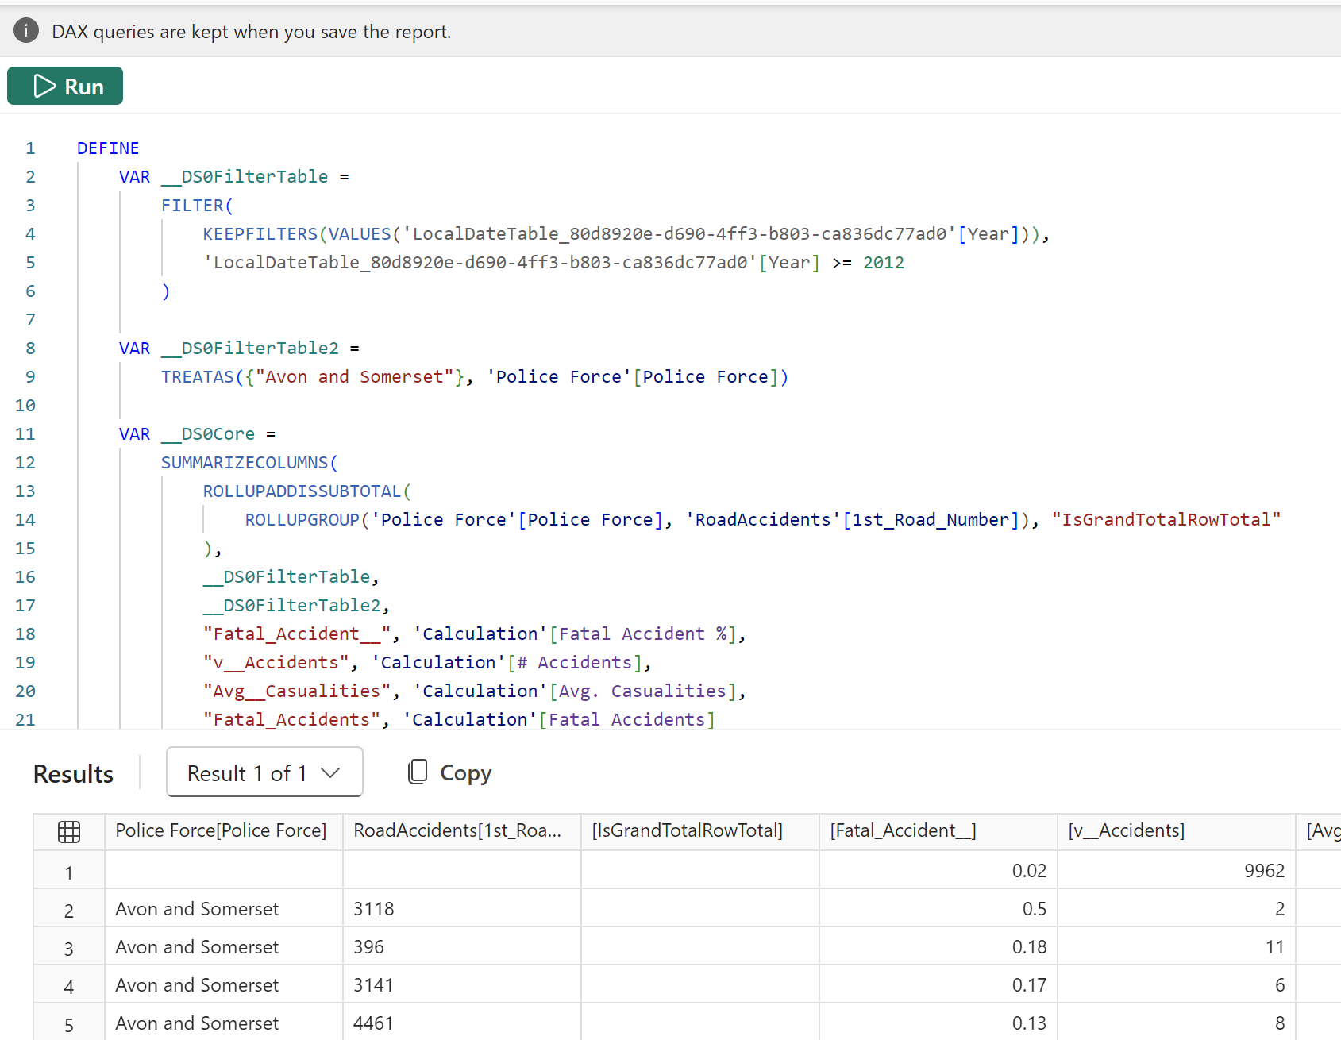
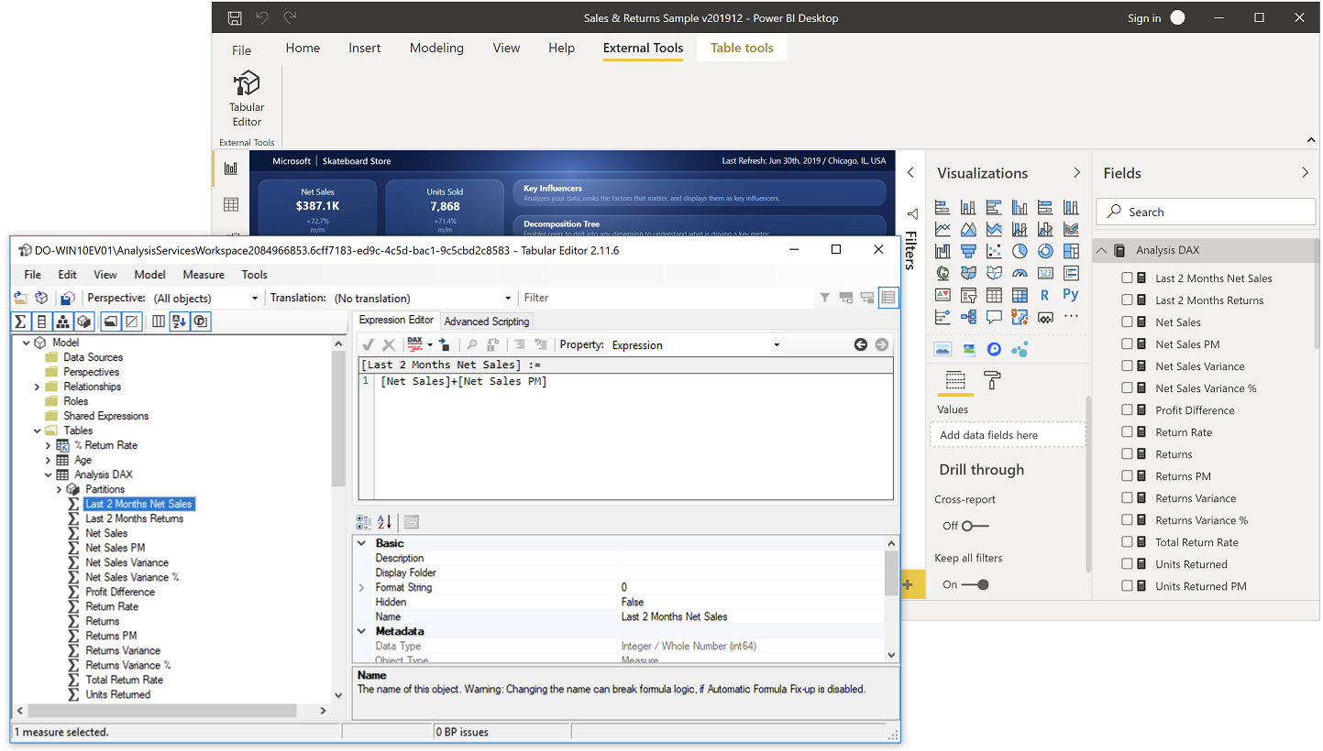
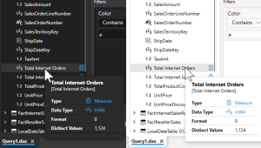
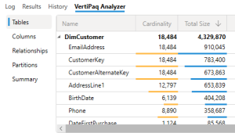
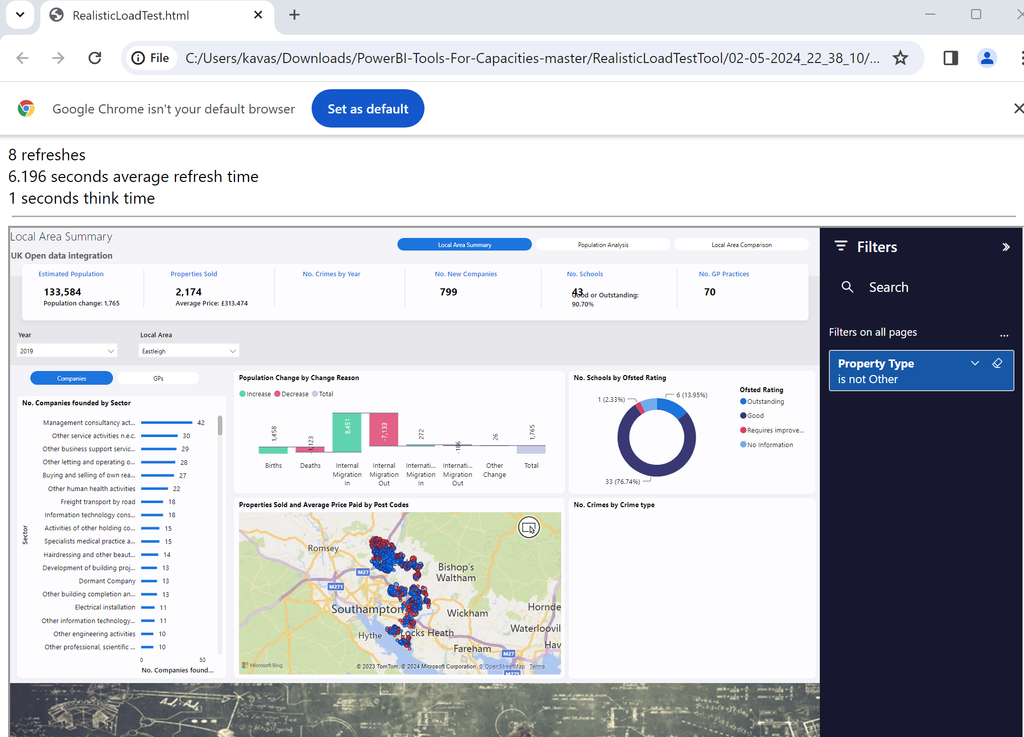
Tools of performance analysis
Power BI Desktop
Performance Analyzer
Dax Query View
Dax Studio
Query Traces
Vertipaq Analyzer
Tabular Editor
Best Practice Analyzer
SQL Server Profiler
Azure Log Analytics
Power BI Realistic Load Testing Tool

Slide 5
Built-in Tools – Power BI Desktop
First step in performance analysis
Performance Analyzer
Dax Query View
Optional: Query Diagnostic

Slide 6
Dax Studio
The ultimate tool for working with DAX queries.
Robust Query builder
DAX Profiler
Query Performance Analyzer
Access to DMV
Analyse models – Vertipaq Analyzer
Data Export capabilities
https://daxstudio.org/

Slide 7
Tabular Editor
Light weight model development tool.
Fast – because it only works with metadata
Efficient – C# scripting
Integrate - CLI
Best Practice Analyser
Can be combined with Vertipaq information for complete model documentation
https://tabulareditor.github.io/
https://www.elegantbi.com/post/vpaxtotabulareditor
https://github.com/microsoft/Analysis-Services/tree/master/BestPracticeRules

Slide 8
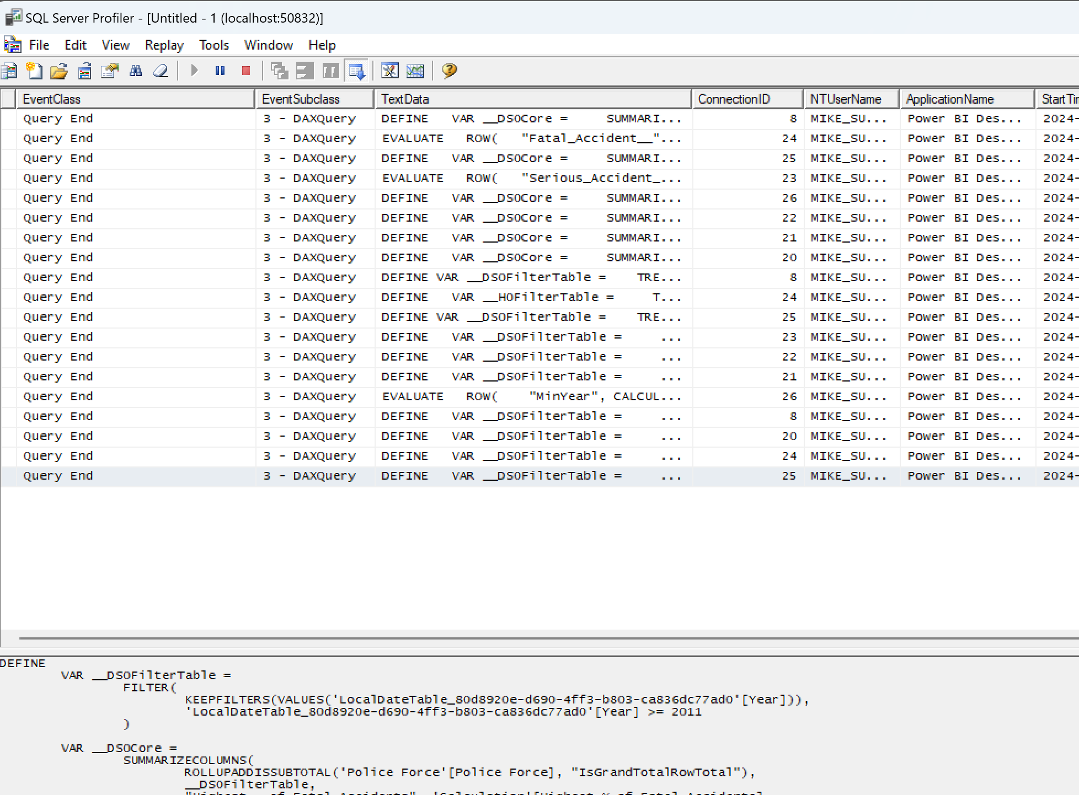
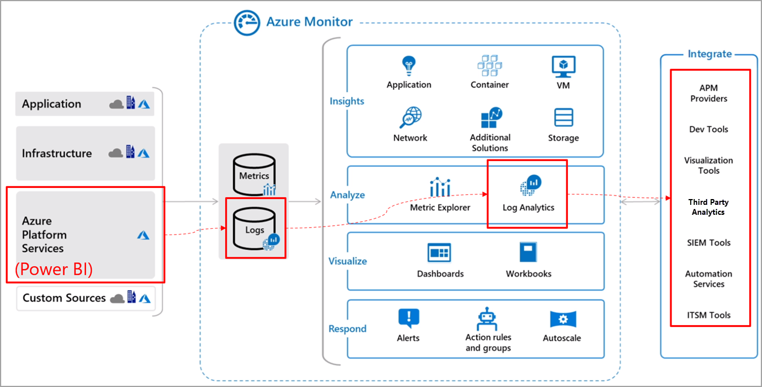
SQL Server Profiler & Azure Log Analytics
Profiler:
Temporary monitoring
Identification of performance problems
Log Analytics:
- Can be set up on the Workspace level
- Premium required
- Keeps the data for 30 days by default
- Relatively low cost
- PBI Template is available
- Combining with Power BI Audit information can enrich the analysis
https://learn.microsoft.com/en-us/power-bi/transform-model/log-analytics/desktop-log-analytics-overview
https://github.com/microsoft/PowerBI-LogAnalytics-Template-Reports

Slide 9
Realistic Load Testing Tool
End user experience testing tool
Multi users experience (testing performance thresholds)
Dynamic interactions with the reports
Can be used to analyse the end-2-end performance
Important:
Results should be treated as guidance not exact values
Need to make sure that the machine running the tool is not the bottleneck -> Running Performance Monitor is recommended (perfmon)
https://github.com/microsoft/PowerBI-Tools-For-Capacities/tree/master

